Slide 1





Introduction to Cadsoft Eagle
Instructor: Theodore Wahrburg

Slide 2

Course Overview:
Build a simple Schematic (.sch)
Create a PCB from the circuit, using the Board Layout Editor (.brd)
Create new parts
Use the CAM Processor to create Industry Standard Gerber files used in fabrication. Course material may be found at https://github.com/waterbury/Makerspace-Classes

Slide 3
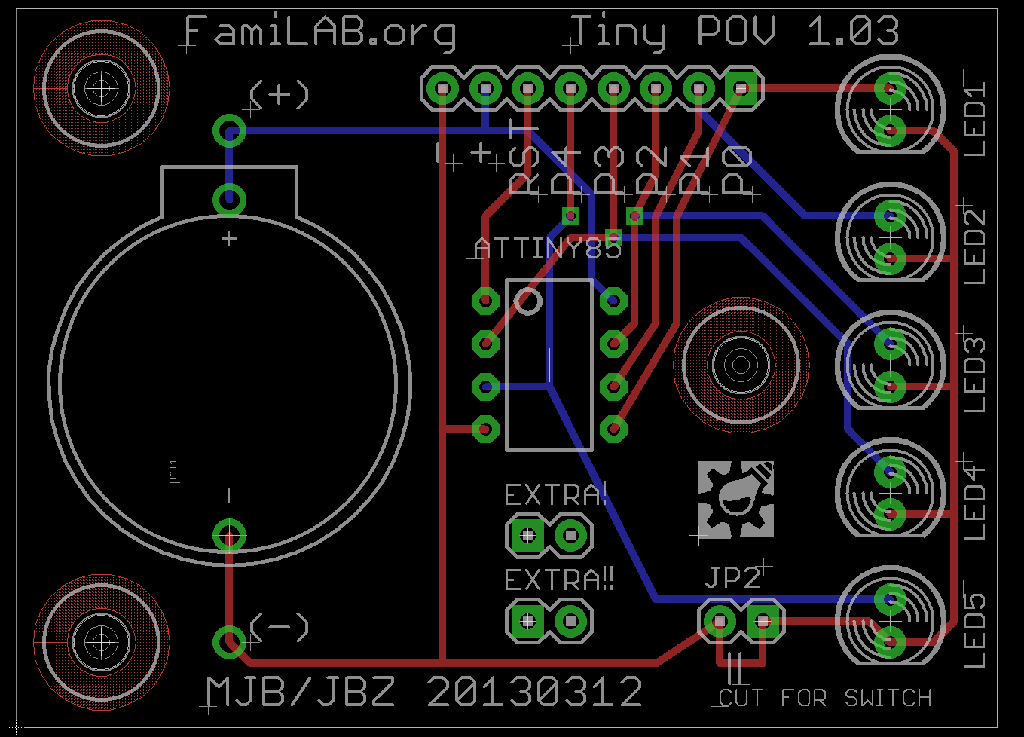
What we’ll be making:
In today’s class, we’ll make an updated version of a Persistence of Vision Circuit Board. When spun at a specific, constant speed it will draw “FamiLAB” in the air. It uses an ATTINY85 microcontroller, along with 5 LEDs to accomplish this. The ATTINY constantly writes to the LEDS the pattern to be drawn. It uses a single button-cell CR2032 for power.

Slide 4

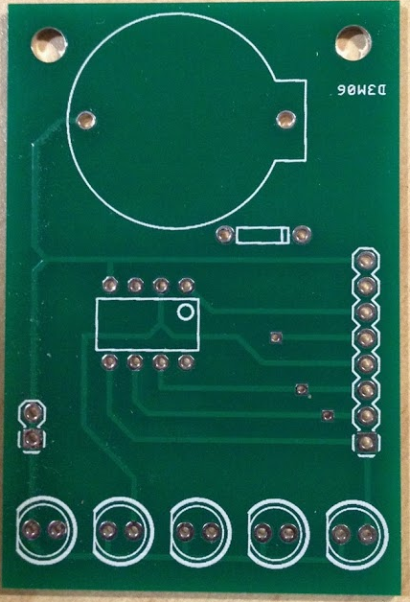
What we’ll be making:
In today’s class, we’ll make a replica of a Persistence of Vision Circuit Board. When spun at a specific, constant speed it will draw “FamiLAB” in the air. It uses an ATTINY85 microcontroller, along with 5 LEDs to accomplish this. The ATTINY constantly writes to the LEDS the pattern to be drawn. It uses a single button-cell CR2032 for power.

Slide 5
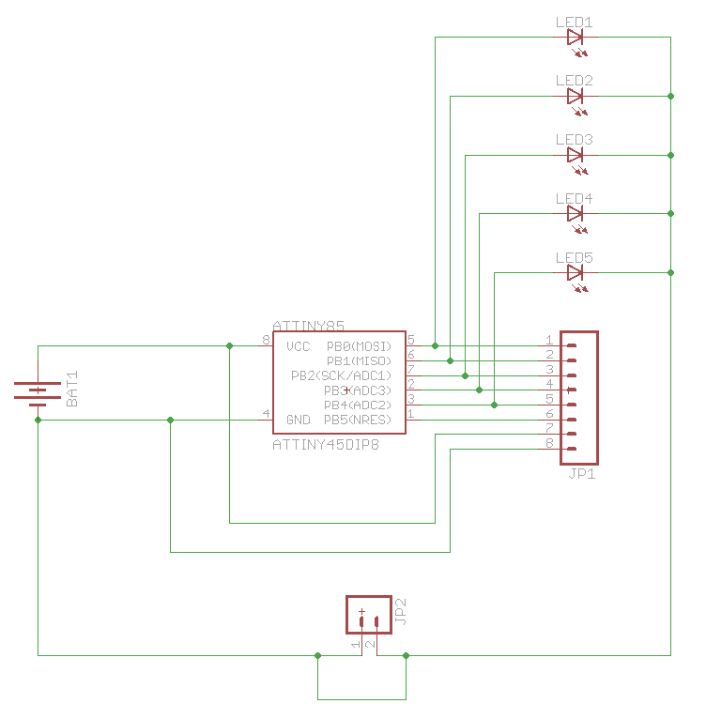
The original Schematic:
Below is the schematic as it appears in it’s Original Eagle Schematic. Our Schematic will look slightly different, but that’s OK. Often times, schematics will be written in notebooks, or napkins, or may be in PDF form, without access to the original PCB files. As you become more proficient in PCB design, and layout you begin to find different ways to draw and layout the same schematic.

Slide 6
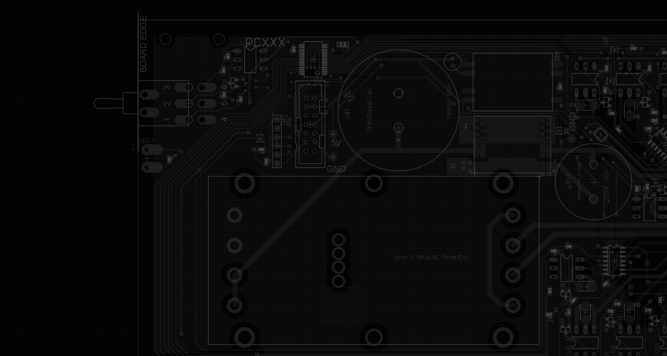
What is Cadsoft Eagle?
Cadsoft Eagle, (Short for Easily Applicable Graphical Layout Editor) is a Printed Circuit Board Schematic, and Board Layout editor that has been around since 1988.
Because of it’s long life, there is a large community supporting it. Beginners will be pleased to find thousands of parts libraries, containing parts for many common components. Even right after installation, Eagle comes with many libraries, with many more available for download from Cadsoft’s website, and elsewhere on the web.
For hobbyists, and students, there is a freeware license, and for small and medium sized businesses, licensing is relatively cheap compared to much more expensive alternatives.
Outside of this class, feel free to watch countless instructional videos on Youtube, and elsewhere. Help is also available on many forums, blogs, and websites. A little piece of advice though. Search for help with “Cadsoft Eagle.” Without specifying Cadsoft, asking Google for help with Eagle brings up interesting results… ☺

Slide 7
How licensing is available for Cadsoft Eagle?
Licensing for Cadsoft Eagle is as follows:
Eagle Hobbyist (99 schematic sheets, 6 signal layers, 160x100mm routing area)
Eagle Light, used in this class (Limitations: 1 schematic sheet, 2 signal layers, 100x80mm routing area)
Eagle Standard (Limitations: 99 schematic sheets, 6 signal layers, 160x100mm routing area)
Eagle Professional (999 schematic sheets, 16 signal layers, 4m x 4m routing area)

Slide 8
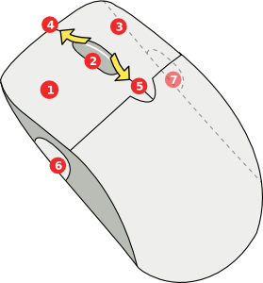
Helpful Movement Tips:
It is advised you use a Two Button Mouse with Scroll Wheel, and that the scroll wheel acts as a Third Button. The buttons are as follows:
Left Click: Use to select tools, and to click on objects.
Center Click: hold while moving the mouse to pan the screen.
Right click: Right click on Objects to display a drop down with options for the object.
Scroll Up: Use to zoom in to sheet.
Scroll Down: Use to zoom out of sheet
6, 7 – Side Buttons: Used as an alternative Zoom in/out.
6, 7 – Side Buttons: Used as an alternative Zoom in/out.

Slide 9
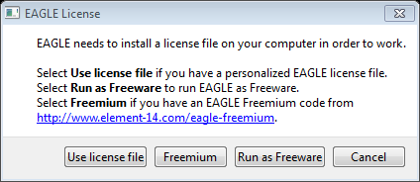
Choosing the License:
Choose “Run as Freeware” when first running Eagle. This will allow using the software with a non-commercial version of the light edition.

Slide 10
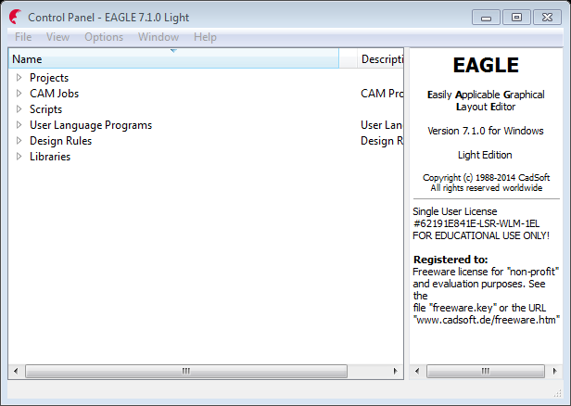
Creating a new Project:
Upon start up, you will be presented with the Control Panel.

Slide 11
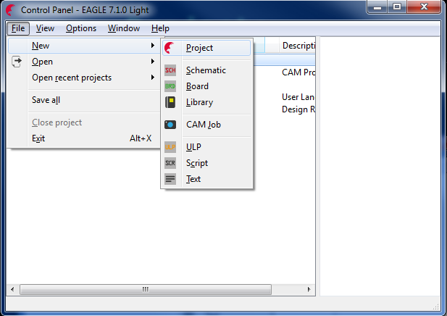
Creating a new Project:
Go to File, Go to New, and choose “Project.”

Slide 12
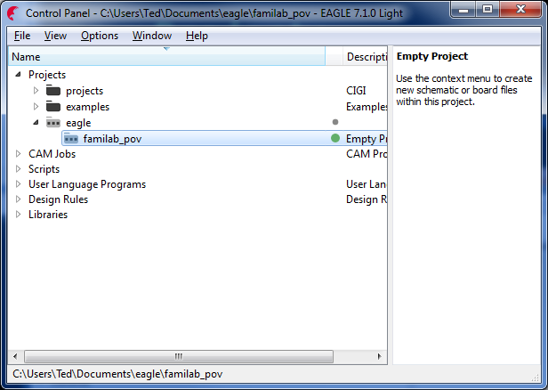
Creating a new Project:
Eagle will create a new Project in Eagle’s default save location, and will request a name. Save it as “familab_pov.” If you mess up, you could right click, and choose to rename.

Slide 13
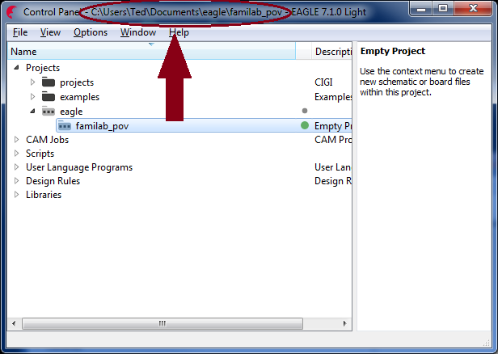
Creating a new Project:
If successful in creating the project, Eagle will immediately load the new project for you:

Slide 14
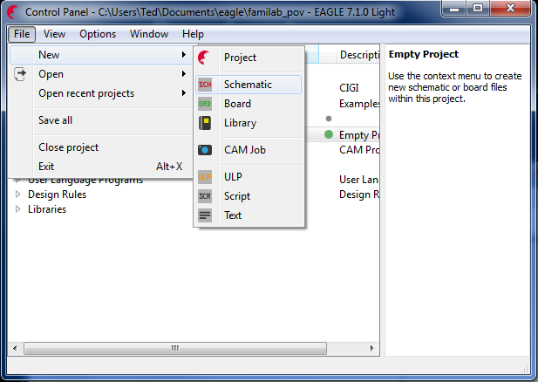
Creating a new Schematic:
With the new project created, and loaded, go back to the File menu, choose New, and select Schematic:

Slide 15
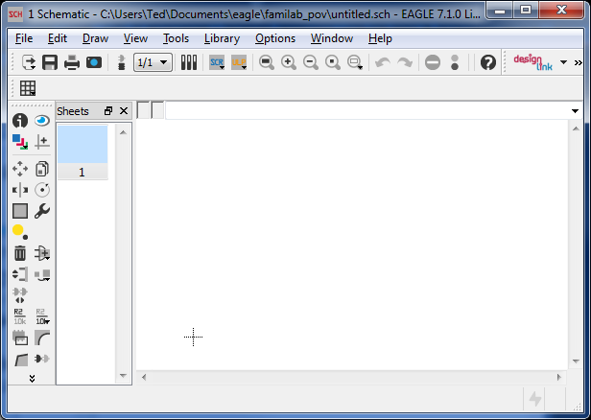
Welcome to the Schematic Editor:
Let’s first save our schematic. Right now the schematic is just known as “untitled.sch,” and will be located in our Project’s directory.

Slide 16
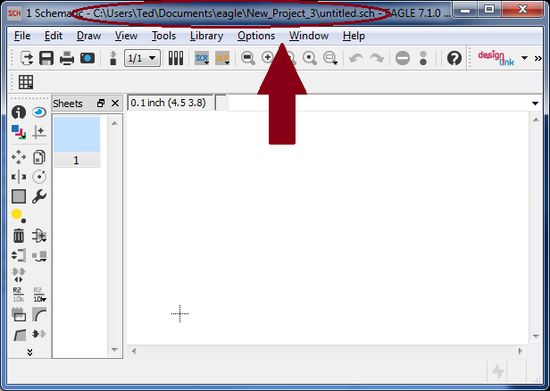
Welcome to the Schematic Editor:
Let’s first save our schematic. Right now the schematic is just known as “untitled.sch,” and will be located in the program’s default saving location.

Slide 17
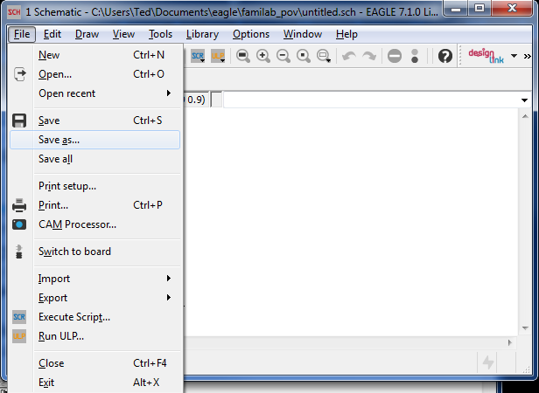
Welcome to the Schematic Editor:
Go back to the File menu, choose Save As, and save the schematic as “familab_pov” as we did with the Project name.

Slide 18
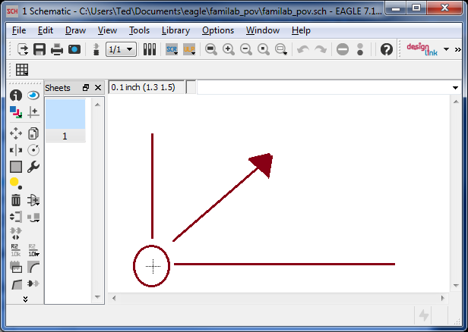
Welcome to the Schematic Editor:
The crosshair represents the origin point of the page. It is at location x:0,y:0. As is common in line graphs, X increases as you go right, and Y increases as you go up. The unit of measurement is user defined. Let’s define it.

Slide 19
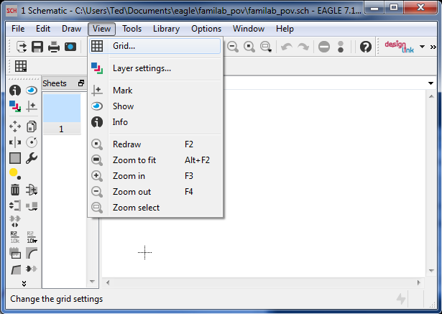
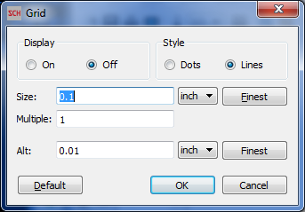
Setting up Units Of Measurement:
Go to View, and choose “Grid.”

Slide 20
Setting up Units Of Measurement:
The Grid Settings are VERY important when working with Eagle. The “Size” sets the space between components, on both the schematic, and board layouts. When set to 0.1”, as is shown below, parts will be placed 0.1” apart when placed by mouse. The “Alt” size specifies movements when “Alt” is held down. In this case, holding Alt would allow placement of components every 0.01”.

Slide 21
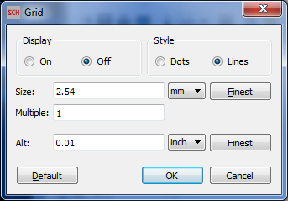
Setting up Units Of Measurement:
I prefer Metric, so I will change the units of measurement to Millimeter. This changes the 0.1” to it’s Metric value, 2.54MM. What makes 0.1” so useful to default to is it’s standard spacing in the Electronic world. Breadboards for example have it’s holes spaced 0.1” apart, and many through-hole components will fit perfectly in them.

Slide 22
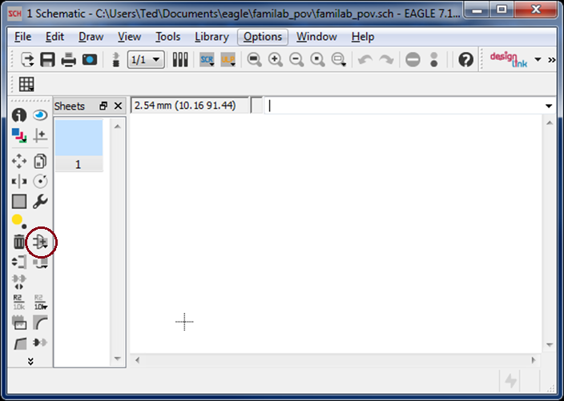
Add a Frame!
Back to the Schematic, let’s add a Frame to frame the schematic into. It’s optional, but is aesthetically very useful, especially during printing. We’ll Add this with the “Add” button.

Slide 23
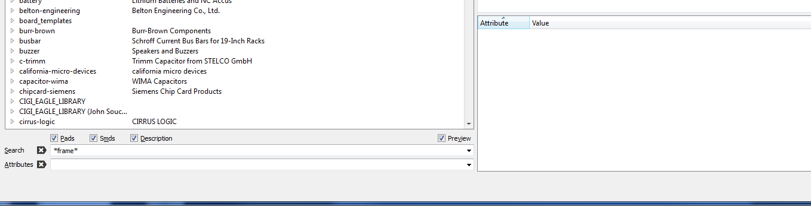
Add a Frame!
Eagle now comes with many libraries. One of which is a Frames library, containing Frames. In the Search box, search “*frame*” The asterisks * is a wild card in Eagle. The wild cards on both sides of frame allow searching for any component containing frame in the name.

Slide 24
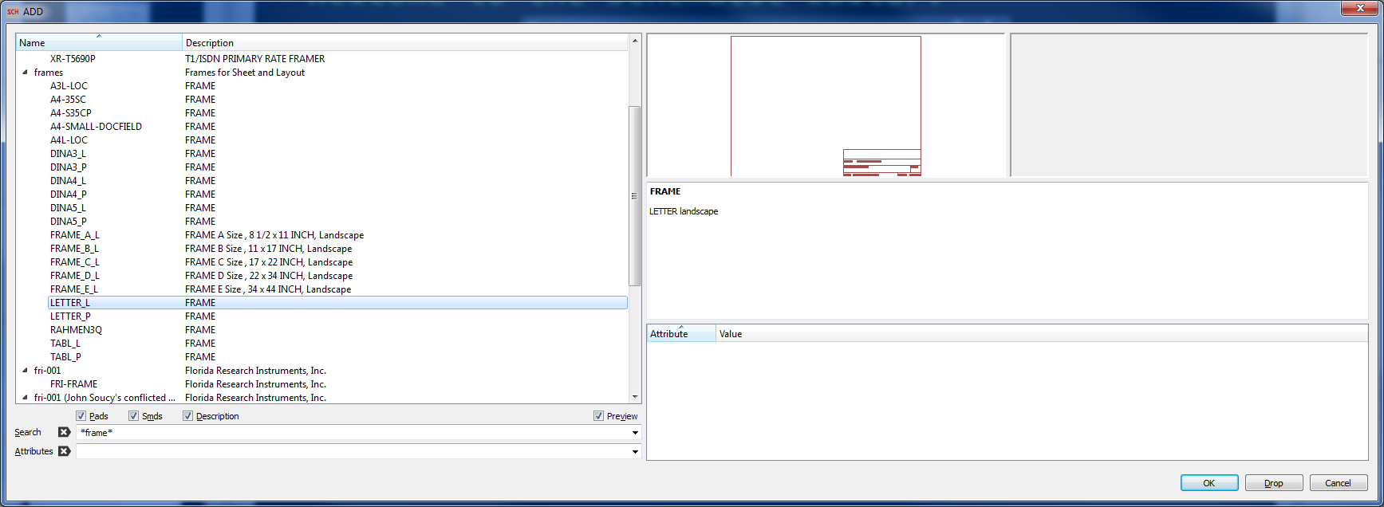
Add a Frame!
We’ll be choosing “Letter_L” in the Frames library. This frame is formatted to fit on a letter sized piece of paper when printed.

Slide 25
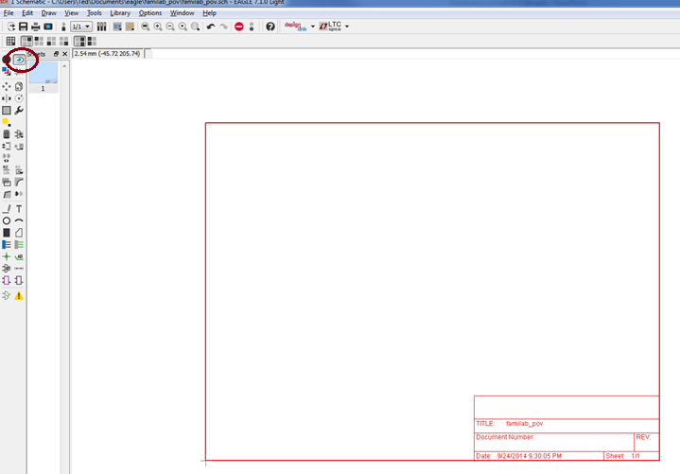
Add a Frame!
Position the Frame so that the bottom left corner is flush with the crosshair point on the page. After, click on the “eye” icon circled on the left to leave “Add” mode, and return to view mode.

Slide 26
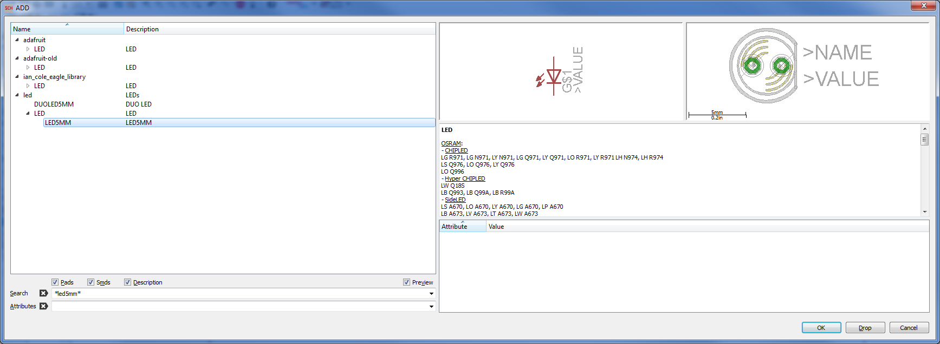
Adding 4 LEDs:
Next we’ll be adding four 5MM LEDs to the Schematic. Eagle 7’s libraries include a Device we’ll use. Go back to “Add” as you did before, and this time search for “LED5MM.” Choose the Package Variant “LED5MM” in the LED Library, under the Device “LED.”

Slide 27
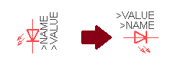
Adding and Rotating Parts:
You’ll now have the ability to place the LED onto the schematic, the same way you placed the Frame, this time we’ll want to rotate the component. With the component still selected, right click your mouse, and the symbol will rotate counter-clockwise. Now place 5 LEDs onto the Schematic. Placing each one below the previous.

Slide 28
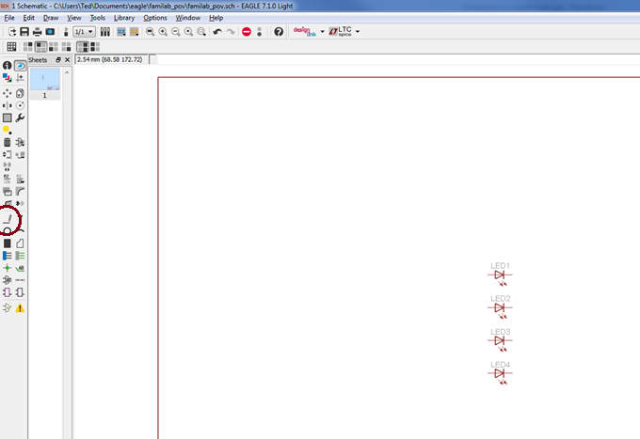
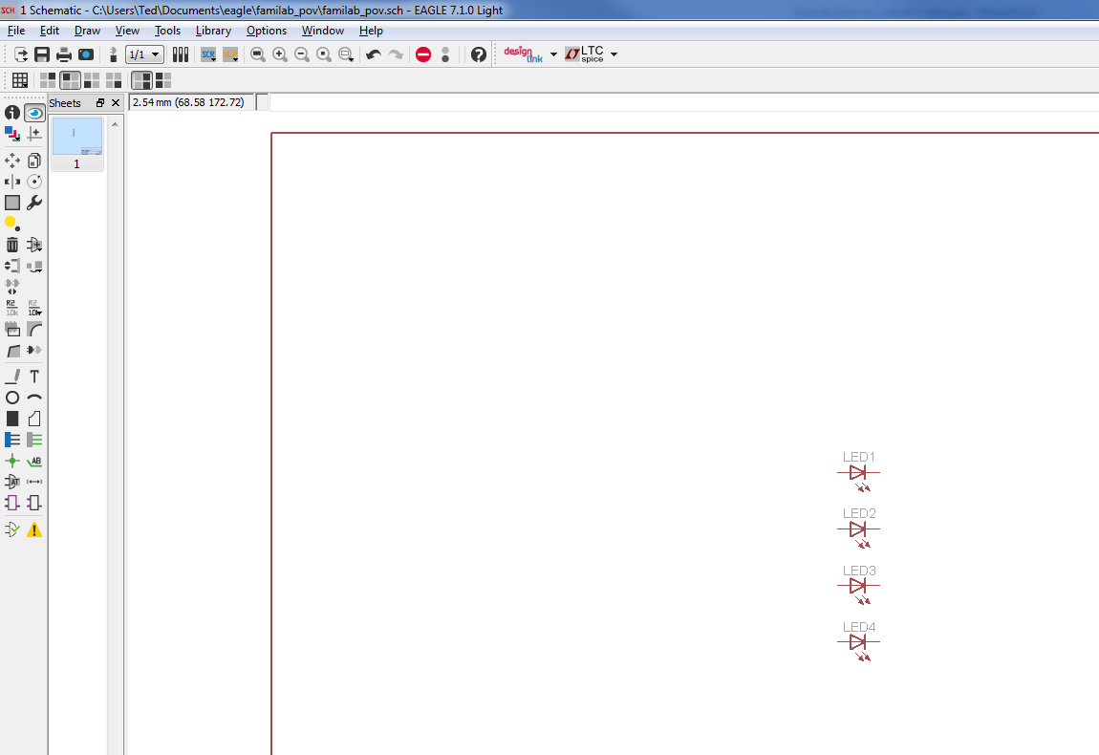
Connecting Components with Wire:
The LEDs should be laid out as such. Next we’ll connect the Cathodes of each LED together to Ground. We’ll select the Wire tool circled on the left.

Slide 29
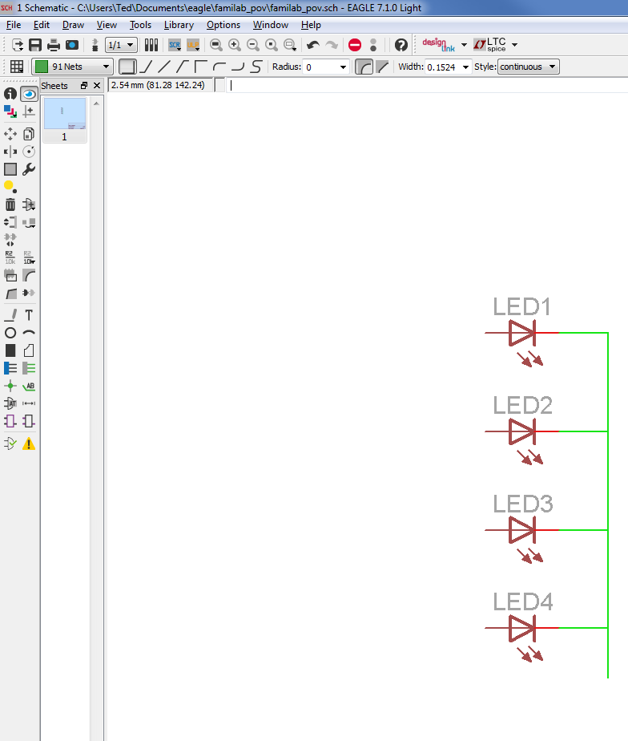
Connecting Components with Wire:
Connect the wires as such. Everything adhering to a standard placement comes in VERY handy on schematic sheets, as it will be very apparent trying to connect a wire on one grid, to one using different placement rules. We’ll be adding a Ground Point to the bottom of the vertical wire shortly, but first we’ll add Junction points after the traces are laid out as such.

Slide 30
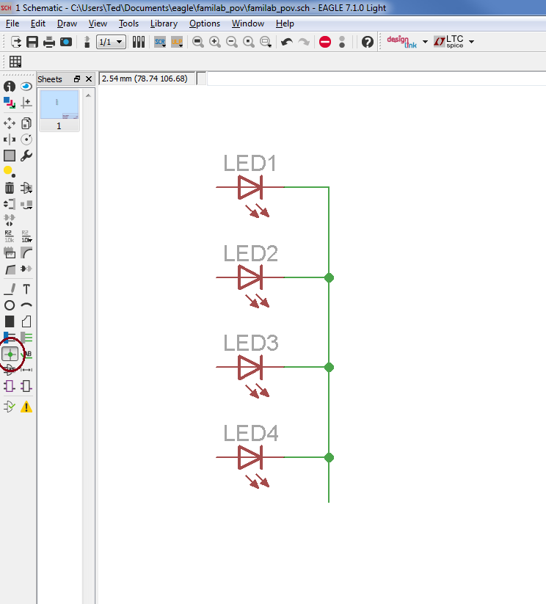
Ensure Wires are connected with Junctions:
Use the “Junction” tool to add Junction (Dots) to each intersection of the wire. This ensures that any overlapping wires that should be joined, but are not already connected will become connected. It also helps those reading the schematic later.

Slide 31
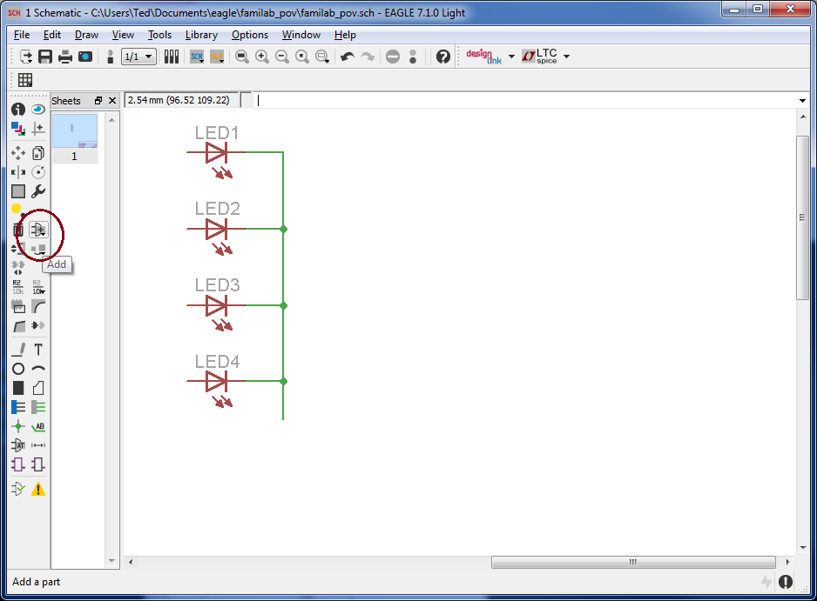
Connecting LED Cathodes to Ground:
Next, we’ll connect all the LED Cathodes to same potential, GND. In Eagle, Wire connections are known as “Nets.” By connecting the Cathodes all to GND, all the cathodes will therefore share the same Net name. We’ll go back to “Add,” and will choose a Supply Symbol that is set up to connect things to a common Supply potential.

Slide 32
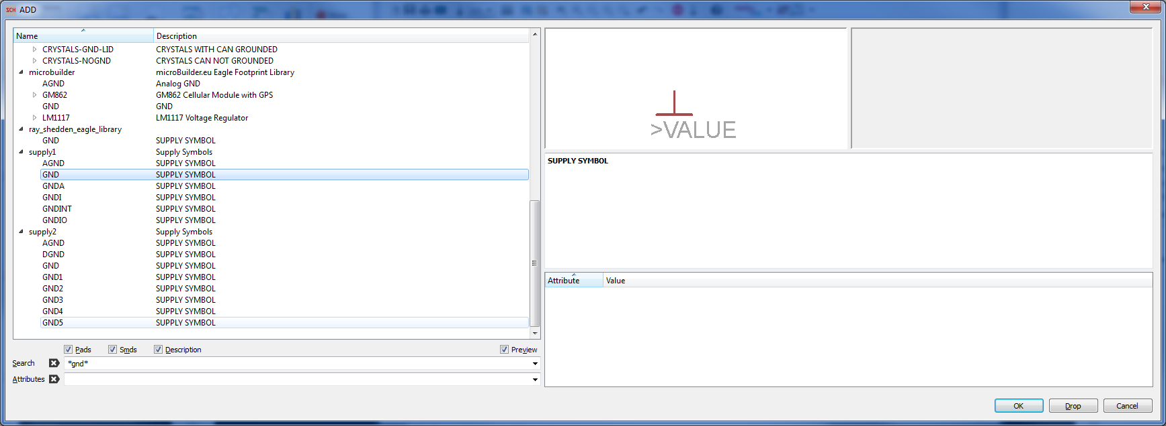
Connecting LED Cathodes to Ground:
Search for “*gnd*” and choose “GND” from Library “supply1.”

Slide 33
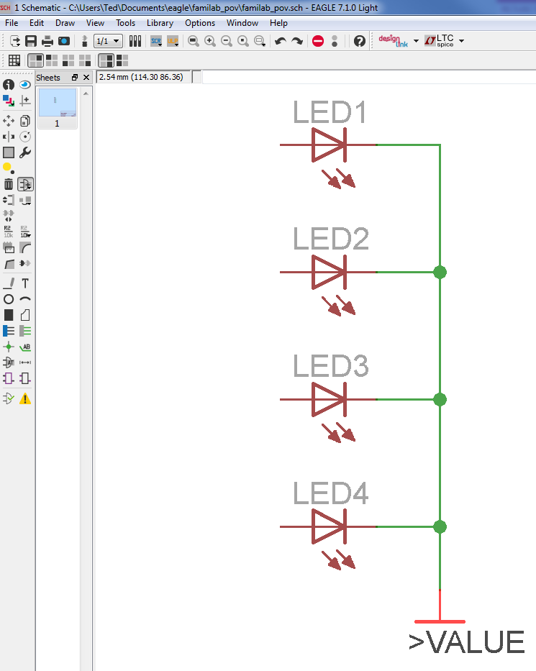
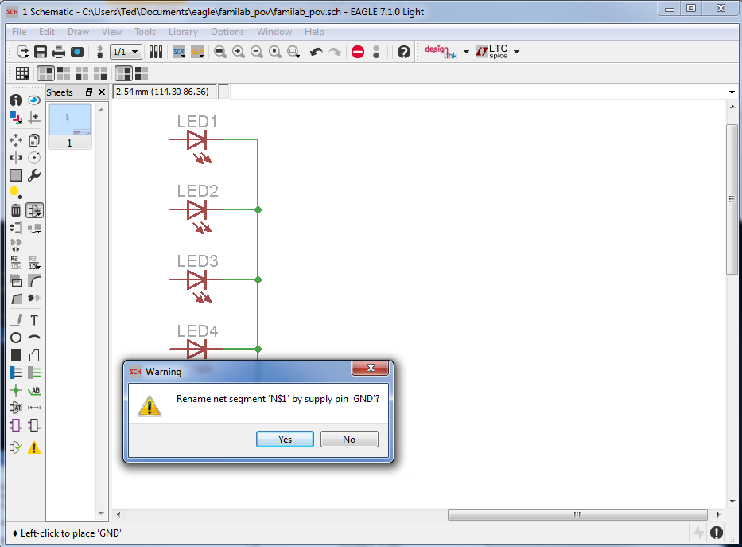
Connecting LED Cathodes to Ground:
Connect GND to the bottom of the Wire Trace you laid previously. You should be asked if you’d like to rename the net segment, in my case ‘N$1’ to GND. Choose Yes. Congratulations, you have just connected the LED Cathodes to Ground!

Slide 34
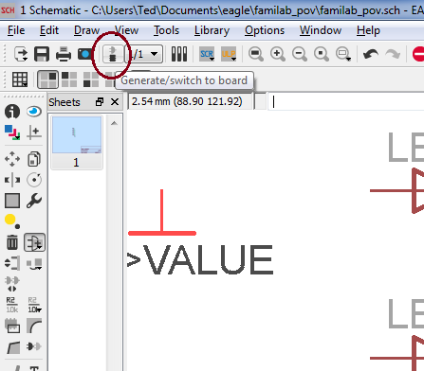
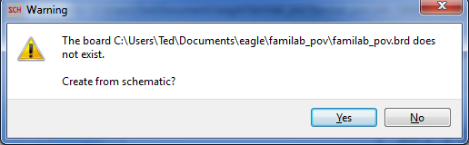
Let’s switch to the Board Layout Editor!
Since we now have four 5MM LEDs connected to the same Ground Potential, let’s switch to the Board Layout Editor to see what they look like, and how they are connected on the other Editor. Click the “Generate/switch to board” button that is circled below. As this is the first time going to the Board view, a Board will be newly generated. Choose Yes on the Warning Prompt.

Slide 35
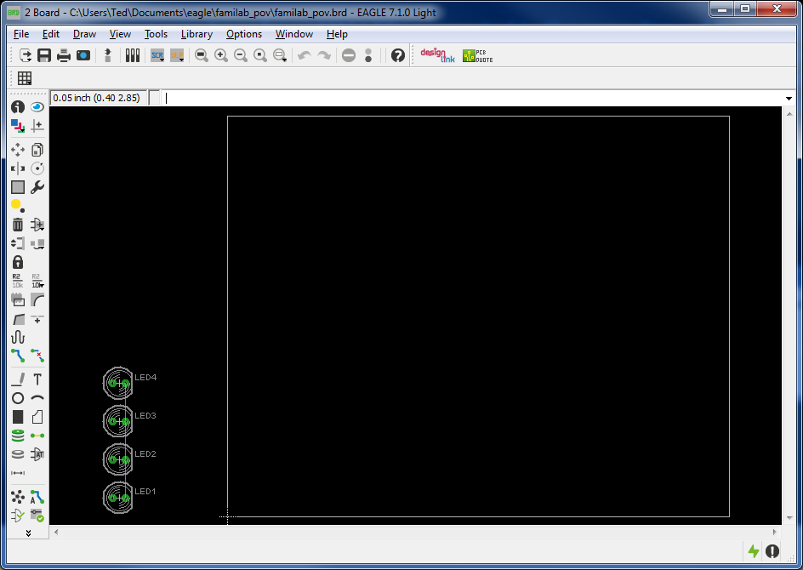
Welcome to the Board Layout Editor!
Laying out components through the Board Layout Editor is similar to the Schematic editor. Like it, there is an origin point, at location X:0, Y:0. It appears that Eagle has laid out an initial Board Dimension, but we will be changing this. Also note, our five LEDs are in the lower left-hand corner. The background is black, but could be changed By Going to Options>User Interface. I prefer the black background, so I’ll be keeping it.

Slide 36
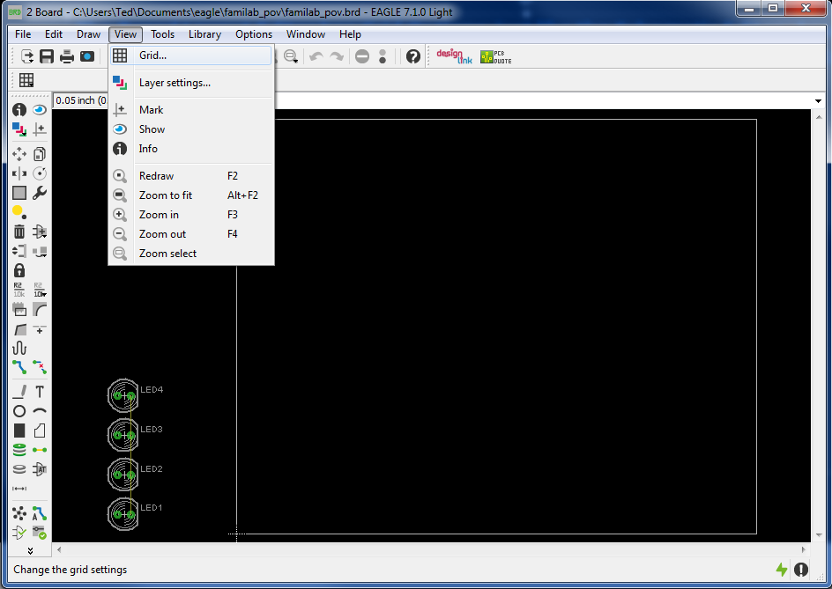
Back to the Grid Settings:
The Board Layout Editor has Grid Options, just like the Schematic Editor. As we are Laying components, often times very specifically, it is good to have a Grid enabled to align parts. We’ll be going back to Grid Settings. Click View, then click “Grid.”

Slide 37
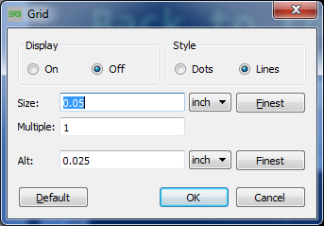
Back to the Grid Settings:
First off, you may notice that our Units of Measurements have reverted, that’s not nice! Let’s change our primary Unit Of Measurements back to Millimeters, and have the spacing be 2.54MM. We could keep the Alternate Unit of Measurements as 0.025” Eagle will use the primary Units for reference, so our sheet will be Metric based. Also, turn the display to “On.”

Slide 38
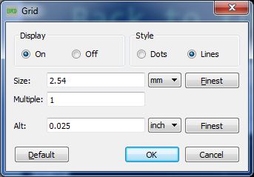
Back to the Grid Settings:
These are the final Grid Settings I will be using. To follow, I urge you do the same. ☺

Slide 39
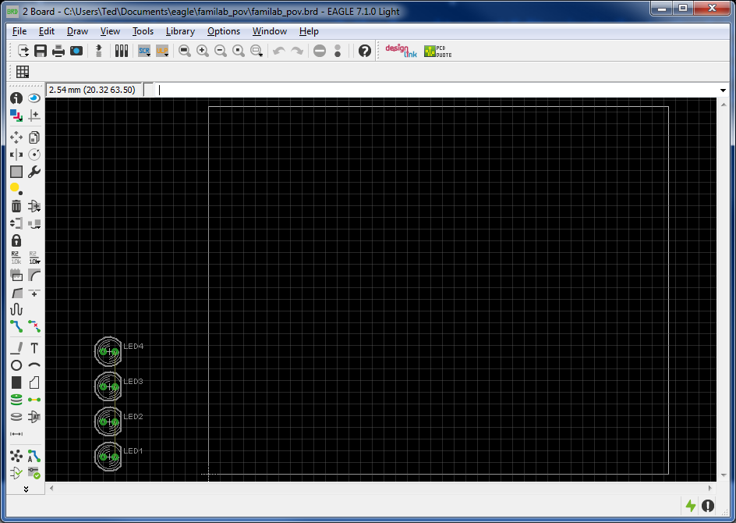
Revised Board Layout Editor!
Returning to the Board Layout Editor, you’ll notice there is now a Grid. The lines will be spaced 2.54MM apart. Much Better! Let’s start moving around the LEDs.

Slide 40
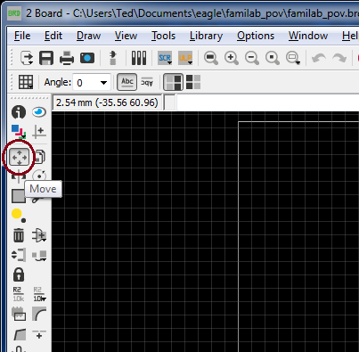
Moving Parts:
To move the LEDs we will choose the Move Tool circled below.

Slide 41
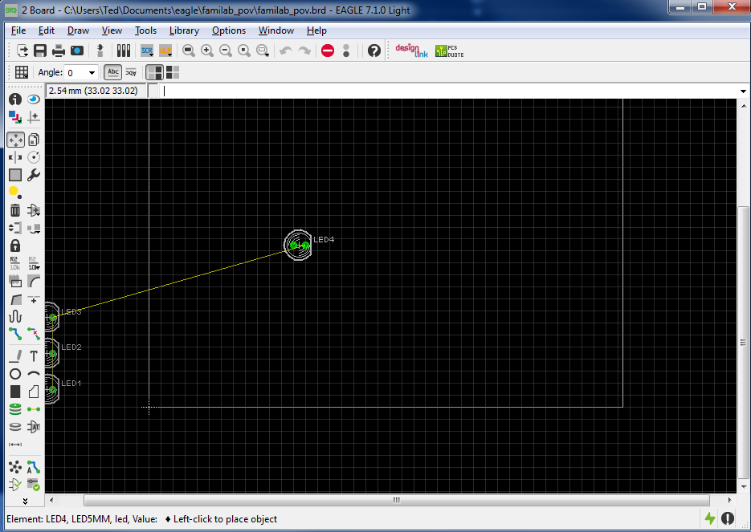
Moving Parts:
Now clicking parts will pick them up, and move them. The wires that hold the parts together are known as “airwires.” I think they look like string cheese.

Slide 42
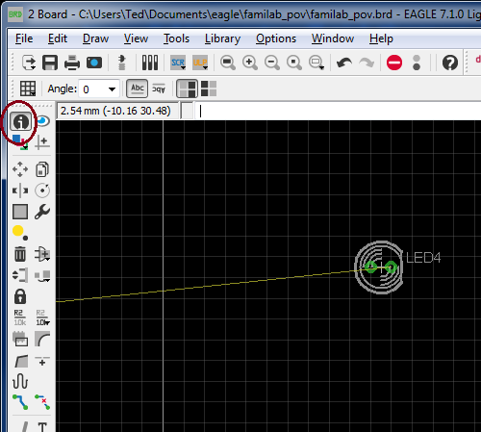
Information about parts:
Place the part down relatively close to the bottom left corner, and click on the Information button selected. With this you could click on an object, and bring up it’s information window.

Slide 43
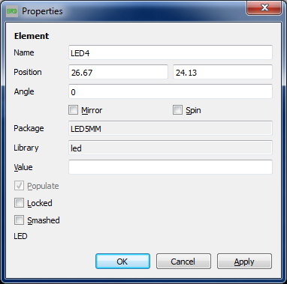
LED5MM Information:
Bringing up the Information on the LED will bring up information such as it’s Name, and Position. Although not specified, the first position number, 26.67 is the X position, and 24.13 is the Y position. Dividing 26.67 by 2.54 gives me 10.5… Wait wasn’t components supposed to be placed evenly apart?

Slide 44
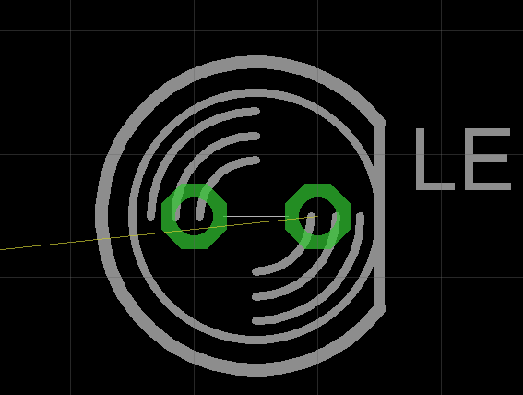
About that LED…
Zooming into the LED, it appears that it’s origin point is between the grid lines. Let’s see how the part is configured. Let’s right click on it, and choose “open package.”

Slide 45
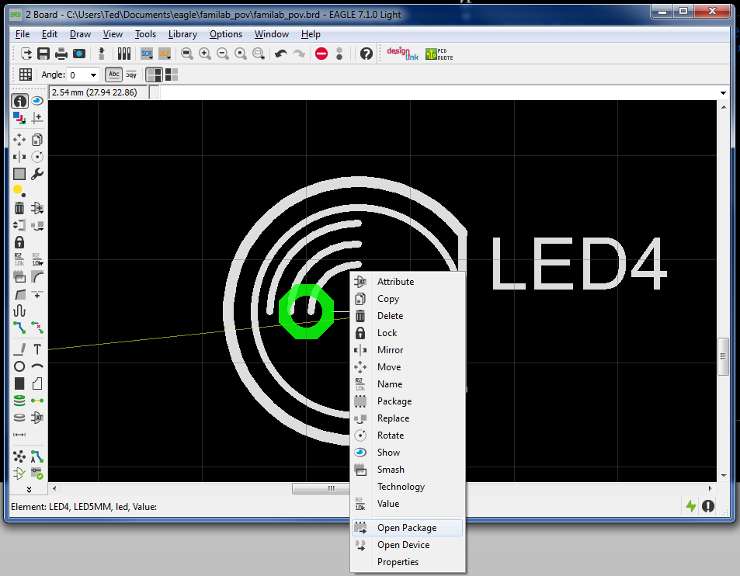
About that LED…
Zooming on to the LED, it appears that it’s origin point is between the grid lines. Let’s see how the part is configured. Let’s right click on it, and choose “open package.”

Slide 46
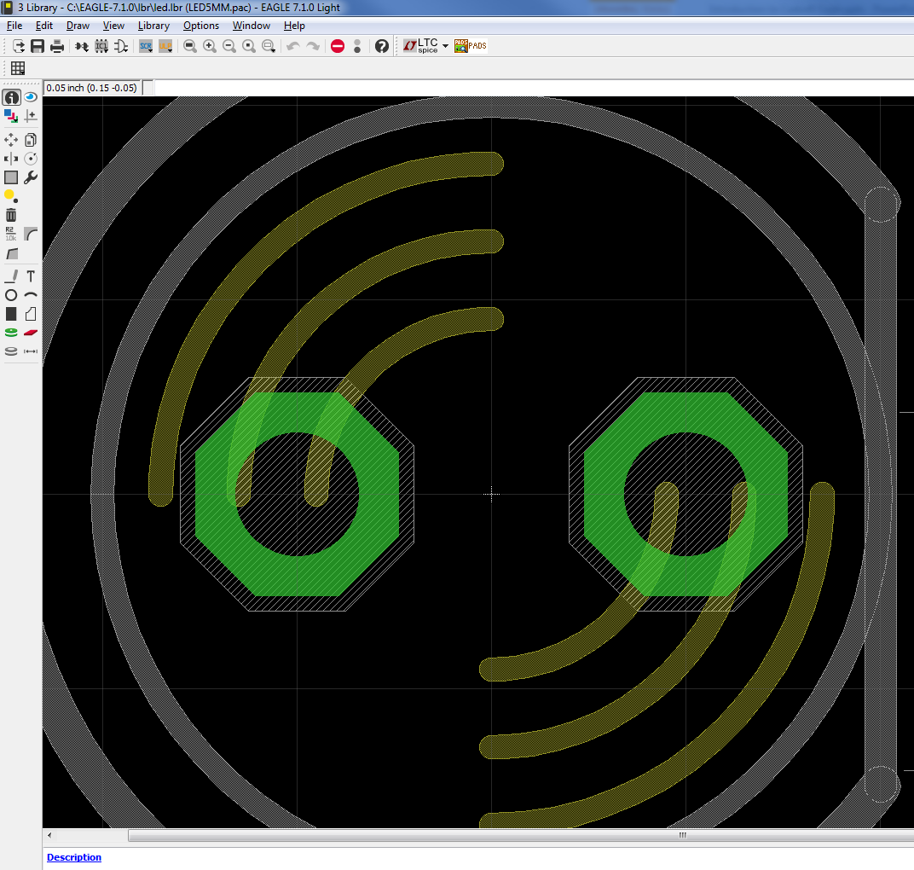
Brief introduction to Package Editing:
Packages are the actual footprints to the components placed on the Board. Creating them is similar to creating Schematics, and Board layouts, in that they have origin points. The author of this part placed the origin straight in the middle. I checked. The pins are 0.1” apart, but are each 0.05” away from the origin points, in their respective directions. There really is no standard on where the origin point will be on the part. Often in the center, or in the corner. Keep this in mind when using parts from different sources.

Slide 47
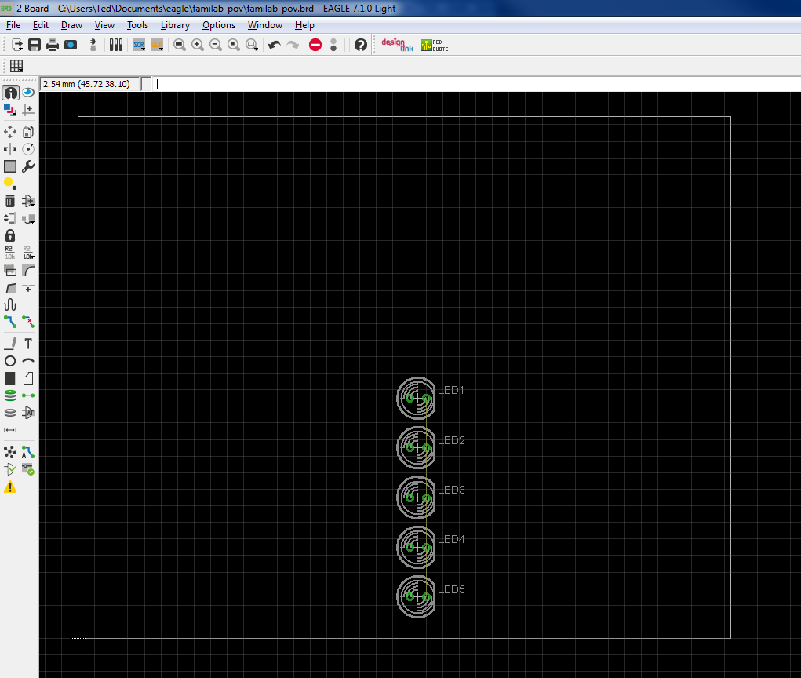
Back to the PCB:
Now that we have an idea on how to position parts onto a Board, and how to look up the position, let’s hard code some custom positions. Lets choose the Information Tool again, and go to the properties of each LED, and change the positions. On the original FamiLAB POV Board, the LEDs were laid out at the following positions: LED 1: X: 52.07, Y: 36.83
LED 2: X: 52.07, Y: 29.21
LED 3: X: 52.07, Y: 21.59
LED 4: X: 52.07, Y: 13.97
LED 5: X: 52.07, Y: 6.35

Slide 48
Changing the Dimension Layer:
Eagle is built on using Layers. The copper that goes on the Top of the PCB is a layer, ditto with the bottom. What determines the edge of the PCB are simply wires on the Dimension Layer. Let’s use the Information Tool to see what the Dimensions are, and let’s resize them.

Slide 49
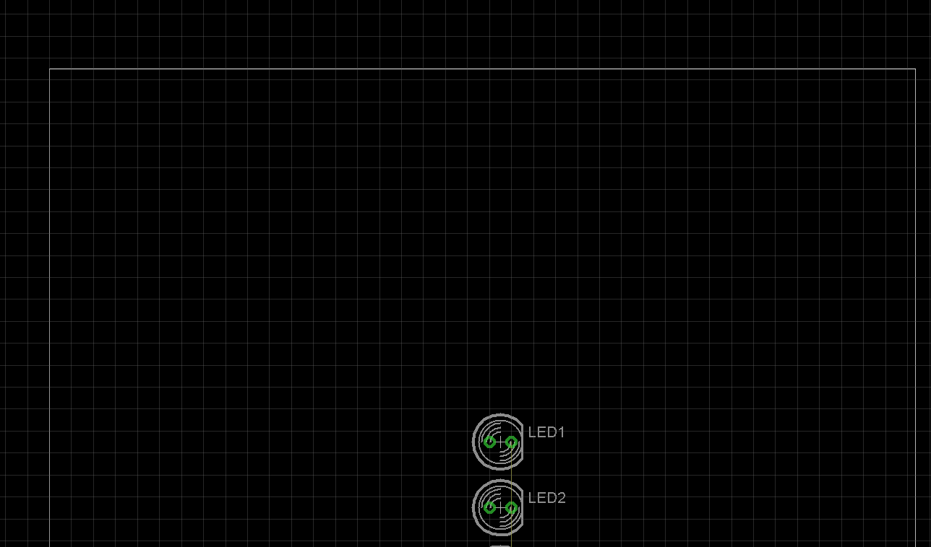
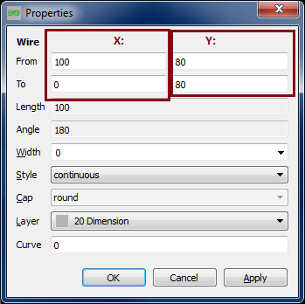
Changing the Dimension Layer:
Here is where it could get confusing. Click the top horizontal line of the Dimension Layer with the Information Tool. You’ll get the X1-X2, and Y1-Y2 Dimensions of the line, but the where the origins are changes based on the line. The X, and Y columns are highlighted, but notice it appears Eagle is showing X2 first at position 100mm, going to 0mm. As We’re looking at a straight horizontal line, it is obvious that 80mm is the Y position. Where the origin of X, and Y are displayed changes based on how you click the line. As we know 80mm is the Y position, lets change it to as it is on the original POV board, to 42.85mm

Slide 50
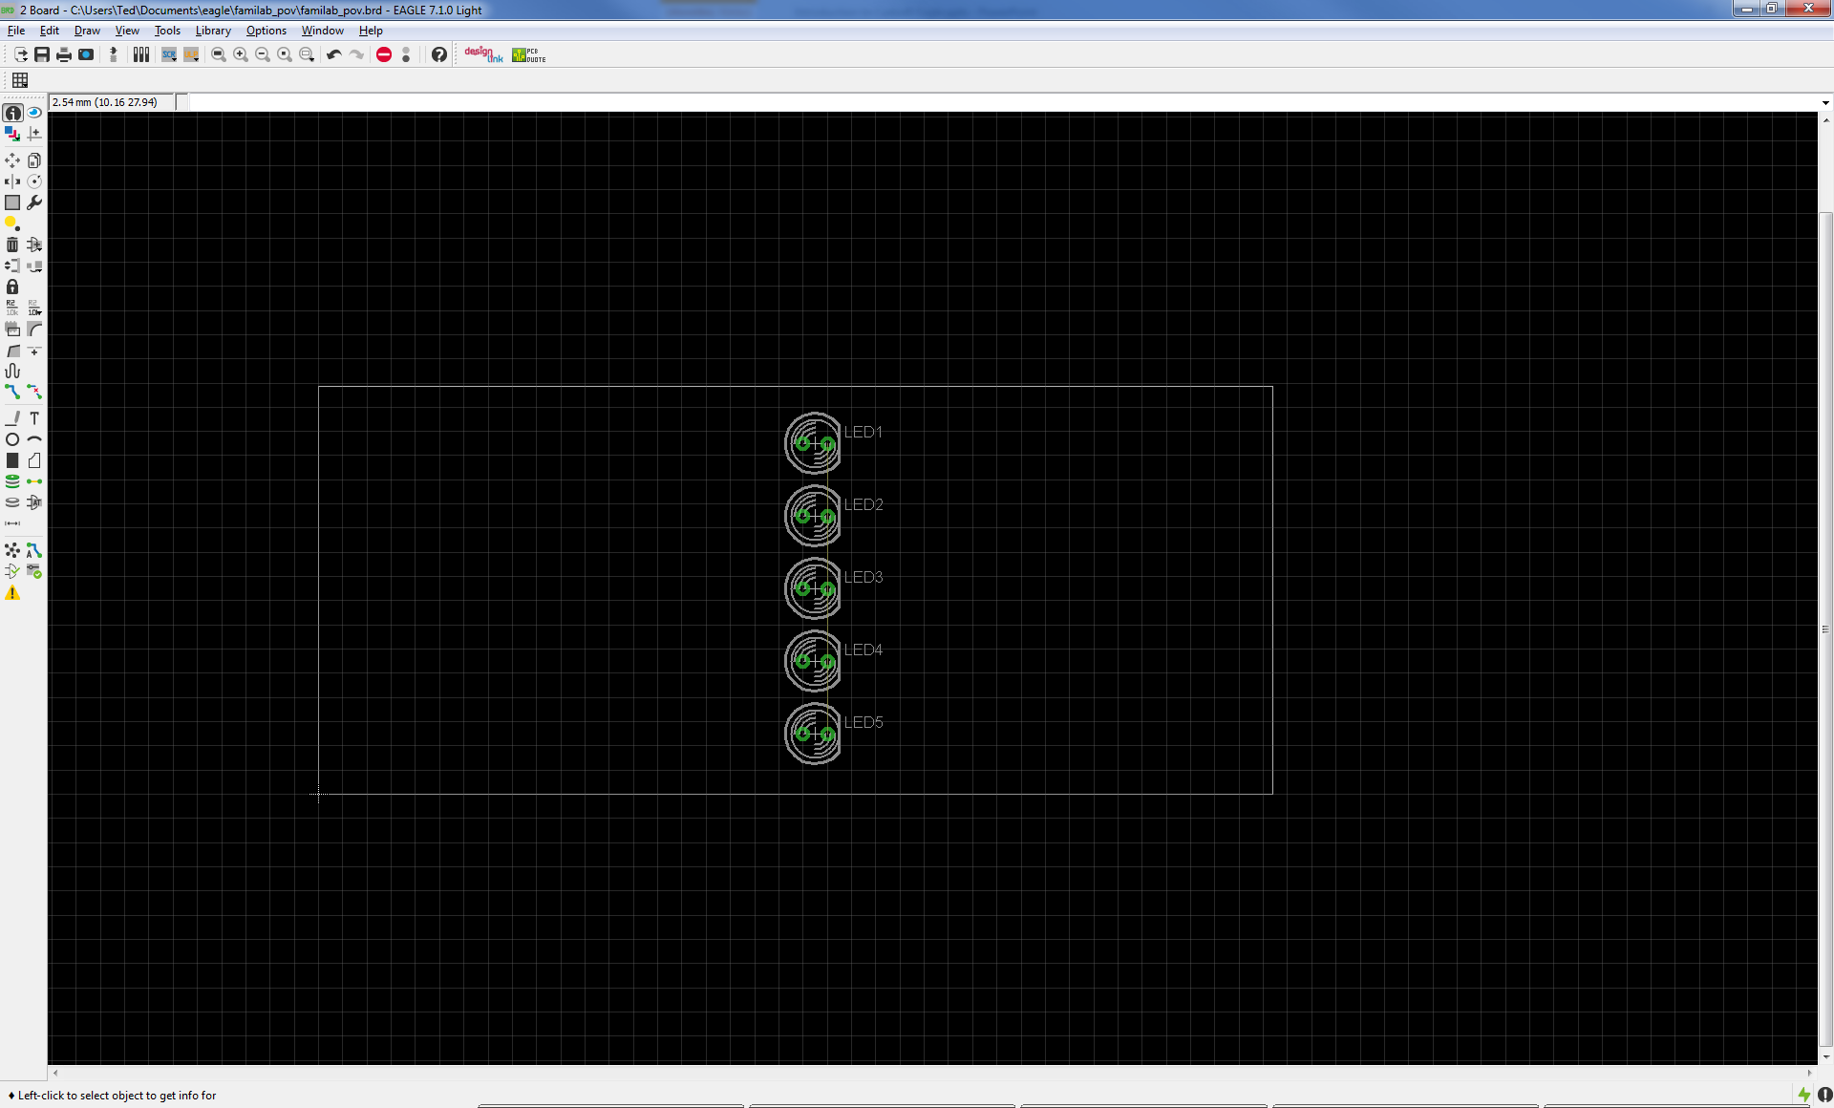
Changing the Dimension Layer:
This will dramatically reduce the Vertical footprint of the Board, let’s now click the right, vertical Wire, and change it’s X Position to 58.4mm.

Slide 51

Final Dimension:
Our final footprint of the PCB will be 58.4mm x 42.85mm. Now lets connect the wires we laid out in the Schematic Editor.

Slide 52


Connecting Wires:
Since we have our LEDs laid out as we want them, and have the wires connected, let’s use the “Ratsnest” tool. This tool cleans up the air wires to find the shortest route to it’s connections, and will tell you how many air wires need to be connected in the lower left hand corner of the window. In this case, we have four airwires. Let’s connect them!

Slide 53


Connecting Wires:
To connect the Airwires, choose the “Route” tool. Once selected, which layer it will be laid out on will Be Selectable on the top. Change the layer from “16 Bottom” to “1 Top.”

Slide 54



Connecting Wires:
Use the tool to connect LED1 to LED2, and LED3 to LED 4, using the top layer. Then switch the Layer to the Bottom, and connect LED 2 to LED 3, and LED 4 to LED5. Also, you’ll have the ability to change the width. The default width shown below is fine for 3V LEDs.

Slide 55

Are they Connected?
Click the “Ratsnest” tool again. If successful, you’ll be rewarded with the following! As our circuit thus far is just connecting 5 LED Cathodes together, as far as the Ratsnest tool is concerned, it’s job is done. There are no more Airwires, but we are only halfway there. Hopefully by now, you have an idea on how to make a simple circuit, and how to connect it with the Routing tool. For the next lesson, we will break apart the traces we laid, and will set down a Copper Pour, Ground Plane to connect the LEDs.

Slide 56

Creating a Copper Pour:
Instead of connecting the Cathodes directly with wire, we are going to create a Copper Pour. A copper Pour is a large piece of Copper left on a PCB where multiple components often connect to. In this case, we’ll use a Pour as a Ground Plane. First choose the “Ripup” tool, and click on the previously made wires to revert them back to air wires.

Slide 57


Creating a Copper Pour:
To create a Copper Pour, choose the Polygon tool as circled below. Then change the layer to “16 Bottom” if it is not already chosen. Layers are changed the same as with the route tool.

Slide 58


Creating a Copper Pour:
Use the polygon tool to create a rectangle in the dimension rectangle. When the loop is closed, the lines should turn to dashes. Now click the Ratsnest button again.

Slide 59

Creating a Copper Pour:
After clicking the Ratsnest button, the polygon becomes a copper pour on the layer chosen. The LEDs are still connected by airwires. We’ll need to change the Net that the Copper Pour is connected on to GND. Your first guess would be to click the polygon with the Information Tool, and change the name the same way we changed the coordinates on the LEDs. Click on the Information Tool, and click the upper left corner of the Polygon to pull up it’s properties.

Slide 60

Linking Copper Pour to GND Net:
Pulling up the Information for the Polygon brings up a host of options. One of which towards the bottom is the Name field. On this specific Polygon, the Name is labeled “N$1.” Try to change it to “GND.”

Slide 61

Linking Copper Pour to GND Net:
Oops! Trying to change the name through the Information Tool does not work. Eagle asks that you use the “Name” tool. So cancel out of the Properties window, and let’s use the Name Tool.

Slide 62

Linking Copper Pour to GND Net:
Choose the “Name” Tool that is circled below. We will then click the upper left hand corner of the Polygon with the tool selected.

Slide 63

Linking Copper Pour to GND Net:
After using the Name Tool with the Polygon, a box will show up allowing you to change the Net the Polygon is connected to. Go ahead and change it to GND, and click OK. After, you’ll be brought back to the Board Layout. Go ahead and click the Ratsnest Tool.

Slide 64


You’ve just created a Ground Plane!
If successful, the airwires should disappear, and the Ratsnest Tool will let you know that there is nothing further to do. Any un-routed Ground Pins touching the GND Polygon will automatically connect to it.

Slide 65

Thermal Pads:
Zooming into one of LEDs will reveal what the Ground connection to the GND plane looks like. Notice how the Cathode is connected using a crosshair. This is known as a “Thermal” connection. Copper Pours could act as heat sinks when soldering. This offers thermal relief to aid in melting the solder.

Slide 66

Thermal Pads:
What if you had a high voltage, or high current connection, and wanted to turn off the Thermal protection? Lets zoom back out, and use the Information tool on the Polygon again. Uncheck the Thermal box, and while we’re at it, change the isolate dropdown to 0.9096mm Radius.

Slide 67


Thermal Pads:
You’ll notice that the GND connection now is fully connected to the cathode pin with no thermal. This will make it a little more difficult to solder the pin, but the issue could be mitigated with a soldering iron turned up to high heat. Now note the other non-connected pin has a large isolation. This is useful for isolating high voltage pins from your Ground Plane, as an example. After we are done, lets go back to the Polygon properties, turn thermal back on, and set isolation back to 0. Remember to run Ratsnest after to redraw the Polygon with new settings.

Slide 68


Rotation:
Going back to the Board Editor, we’ll need to rotate the LEDs so that their flat Cathode side is facing down. Keep clicking on the LED until it rotates to this position. Note, the LED appears to rotate rather well. If the origin point was off center, this wouldn’t be the case. The Rotate Tool is circled below. The two LEDs already rotated are pointed out below with arrows.

Slide 69

Rotation:
After all the LEDs are rotated, our Ground Plane will need to be redrawn. Click the Ratsnest again to redraw it. Now that everything is seated correctly, we’ll clean up the text on the Silk Screen layer using the Smash command.

Slide 70

Eagle SMASH!
The LED’s Text name moves as one with the LED. Select the smash command to disconnect the Text from the part.

Slide 71


Eagle SMASH!
Clicking one of the LEDs with the Smash Tool adds a separate point for moving the Text, as is shown in the right picture. After using the tool on all the LEDs, we’ll use the Move Tool tidy up the text.

Slide 72

Tiding Up the Text:
Text tidied up:

Slide 73

Creating a Part for CR2032 Battery:
Next we’ll create a part for the CR2032 Battery Holder:

Slide 74

Creating a new Library:
First, go to Window, and choose the Control Panel:

Slide 75

Creating a new Library:
In the Control Panel, go to File, then New, and choose Library:

Slide 76

Creating a new Library:
We’ll be brought to an untitled Library Window. Go to File, and choose “Save as”:

Slide 77

Creating a new Library:
Eagle should bring us to it’s default Library folder. Let’s save our new Library in it, and name it “pov_class” :

Slide 78

Creating a Package for CR2032 Battery:
With the Library saved, let’s create our first part! Go to Library, and choose Package:

Slide 79


Creating a Package for CR2032 Battery:
In the New field we’ll enter our Package name. The Part’s Manufacture Part Name is BC2032-F1. Since I want the part name to start with CR2032 to indicate it’s use, I’m going to name the package “CR2032_BC2032-F1” . Package names cannot be lower case, or contain spaces. After clicking OK, Eagle will verify you would like to create a new package. Choose Yes:

Slide 80

Creating a Package for CR2032 Battery:
We’ll be brought to a new Package Window. First let’s check our Grid size. Go to View, then click on View, as we have previously.

Slide 81

Setting Up Grid:
You may notice that our Grid has been reset yet again. Let’s make our spacing be 2.54 Millimeter apart. The spacing isn’t so important, as our Battery Holder will have precise spacing, but the Units of Measurement is.

Slide 82

Looking Up Datasheet:
With the Grid set, let’s find the footprint of our package. Often electronic suppliers, in this case Digikey, will link to a part’s datasheet on it’s product page. Let’s open it, and use it as a guide for our part’s footprint:

Slide 83

Obtaining Package Footprint:
It appears that the Datasheet does indeed include the Footprint. We’ll use it to create our package:

Slide 84


Redrawing Footprint in Eagle:
The part has two SMD pads. One for the Positive Terminal, the other for the Negative. We’ll make Pads with the SMD Tool Circled below:

Slide 85

Redrawing Footprint in Eagle:
Let’s place two SMD pads on the grid. One at position 0,0 , the other right of the first. The position of the second pad doesn’t matter, as we’ll reposition it shortly. :

Slide 86



Changing Pad Size:
Now it’s time to resize the pads to be 3.29mm x 3.29mm in length, and width. One way of doing this is with the Change Tool. The Change Tool allows batch changes, as each click changes an object to the parameters chosen. In this case we’ll change the SMD pad size. First, click the Change tool (Wrench Icon) go to SMD, and choose “…” to manually enter a value. :

Slide 87

Changing Pad Size:
In the Change Smd window, enter 3.29 x 3.29, and click Ok:

Slide 88


Changing Pad Size:
Now clicking on a Pad will change it size. Click on both pads to change the size of both. :

Slide 89

Changing Pad Size:
We could only position the SMD pads at the center point. However, this datasheet has the distance from the front of the first pad to the outer edge of the second. As we know the width of both pads is 3.29mm, the center point is 1.645mm in. If we subtract 1.645mm from the left, and 1.645mm from the right, we’ll be left with 30.97mm from the left pad’s center point, to the center point of the right pad. I super imposed these values on the left image.

Slide 90

Lining Up Pads:
Using the Information Tool, Click on the right SMD Pad to bring up it’s info. Let’s move it’s X Coordinate to be at 30.97mm. We’ll just keep the left SMD pad at position 0,0.

Slide 91


Renaming Pads:
Now we’ll use the Name Tool to rename the Pads. First we’ll click on the left Pad, and rename it to “POS” to represent the Positive Terminal. Next, we’ll click on the right Pad, and rename it “Neg” to represent the Negative Terminal.

Slide 92



Using Text to show Polarity:
Next, we’ll use the Text Tool to place a “+” symbol next to the positive terminal. We’ll place it on the “tPlace” layer, and will size it’s height at 1.778mm, with Vector Rendering.

Slide 93

Using Text for guiding with Placement:
Purely cosmetic, I used the circle tool to create a circle on the “tPlace” layer in the center of the pads. I also placed the name of the component using the Text Tool in the center. This time, I placed it on the “tNames” layer.

Slide 94

Printing Package:
One of the coolest features is using a standard printer to print a 1:1 representation of the package. With it, you could print out the footprint, and see if the footprint matches the part long before fabrication.

Slide 95

Printed 1:1 Package:
Looks good to me! In fact it leaves room to do surface soldering, outside of a reflow oven.

Slide 96



Creating a Symbol for Batteries:
Now that we have a footprint for the package, we’ll need to make a symbol to represent it on the schematic. Go to Library, and choose Symbol. We’ll name this Symbol “SINGLE_BATTERY” . As before, choose Yes on the warning.

Slide 97


Changing Grid….Again:
You’ll be brought to the Symbol Editor, but first, go to View->Grid, and set the Units of Measurement to Millimeters, and the spacing to 2.54mm.

Slide 98


Creating a Symbol for Batteries:
We’ll want to recreate the Battery Symbol as shown on the right. First, choose the Wire Tool as circled on the bottom left.

Slide 99

Creating a Symbol for Batteries:
After drawing the lines, we’ll click on the “Pin Tool” to draw some pins we’ll connect to in the schematic.

Slide 100

Creating a Symbol for Batteries:
Use the tool to connect the pins as shown in the bottom left.

Slide 101


Creating a Symbol for Batteries:
Let’s use the Text Tool again to indicate polarity.

Slide 102
Creating a Symbol for Batteries:
Let’s use the Text Tool again to indicate polarity.

Slide 103



Creating a Symbol for Batteries:
Next we’ll use the Name Tool to rename the Pins. The top Pin will be named “POS” and the bottom “NEG”

Slide 104


Creating a Symbol for Batteries:
Choose the Change Tool, and go to Visible, and choose “off” Next, click on both pins. This will turn off the automatic Name Text on both the Schematic, and Board views.

Slide 105



Creating a Device for CR2032 Battery:
Next we’ll be creating a Device for our Part. A Device takes one or more Schematic Symbols and connects it to Package Footprints. Devices such as Atmega microcontrollers come in multiple footprints, some for through hole, and some for surface mount. These are known as Variants. In today’s case, we’ll only have our BC2032-F1 package to connect to our device. Go to Library, and choose “Device” We’ll name it “CR2032_HOLDER” as you may reuse it for different CR2032 holders. Be sure to choose Yes on the warning:

Slide 106


Creating a Device for CR2032 Battery:
The new Device window is unlike the other editors. Click on the “Add Tool” on the left, and choose the Symbol we just created:

Slide 107


Creating a Device for CR2032 Battery:
We’ll place the part in the center of the crosshairs, and then click on New on the lower right. After, choose the “CR2032_BC2031-F1” Package we made earlier:

Slide 108



Creating a Device for CR2032 Battery:
An exclamation mark means we’ll now need to connect the Pins from the Symbol, to the SMD Pads from the Package. Click Connect, and connect the “NEG” Pin to the “NEG” Pad, and the POS Pin, to the POS Pad:

Slide 109

Creating a Device for CR2032 Battery:
Congratulations, you’ve just created your first Part! Be sure to save, and let’s return to our Schematic:

Slide 110


Adding Battery to Schematic:
Click on Window, and choose Control Panel. Now, in the Control Panel, expand Projects, familab_pov, and open our “familab_pov.sch” Schematic:

Slide 111


Adding Battery to Schematic:
Back in our Schematic, click the Add Tool again, and Search for “*CR2032*” be sure to wildcard both the front, and back with ‘*’ wildcard. Select the Part, and drop it into our Schematic:

Slide 112


Adding Battery to Schematic:
Next, use the Copy Tool, and click on the GND Symbol to copy it. Drag the copy, and place it below the new Battery Symbol. Then, use the Wire Tool to connect the Symbol to the new GND Symbol:

Slide 113

Adding Battery to Schematic:
Now click the Add Tool again, and Search for “*VCC*” be sure to wildcard both the front, and back with ‘*’ wildcard. Select the Part, in the “supply1” Library and drop it into our Schematic directly above our Battery Symbol:

Slide 114

Adding Battery to Schematic:
Use the Wire Tool to connect the Battery to the new VCC Symbol:

Slide 115


Adding Mounting Holes:
Back to the Board Editor, you’ll see that our package is now on the Board Editor. Before we move it, let’s add some Mounting Holes. Click on the Hole Tool :

Slide 116



Changing Radius of Mounting Holes:
Position two Mounting holes on the Board. One on top of the other. Then choose the Change Tool, and choose “…” to manually enter a value. In this case 3.048mm Radius :

Slide 117


Repositioning Mounting Holes:
Click on the two Mounting Holes, and the Diameter will expand. Next, choose the Information Tool, and change the Coordinates of the first hole to X: 5.08mm, Y: 38.1MM. Change the Coordinates of the second hole to X: 5.08mm, Y: 5.08mm:

Slide 118
Repositioning Battery:
Next we’ll reposition the battery. :

Slide 119




Repositioning Battery on Board Layout:
To move the Battery Holder, first use the Rotate Tool to Rotate it so the Positive Terminal is facing up. After, choose the Information Tool, and change the Coordinates of the part to X: 29.2mm, Y: 39.37MM. This will place the battery in the Horizontal middle of the Board.

Slide 120

Importing Sparkfun Library:
Electronic Hobbyist supplier, Sparkfun offers their Eagle Libraries as Open Source on Github. It could be found at https://github.com/sparkfun/SparkFun-Eagle-Libraries There are many ways to grab files from Github, but for this class, we’ll choose to Download the ZIP.

Slide 121

Importing Sparkfun Library:
After you download the Libraries, unzip them. Where you unzip them doesn’t matter in the context of this class, but note where they end up.

Slide 122


Importing Sparkfun Library:
After extraction, return to the Schematic, go to Library, and choose Use. Navigate to the extracted folder, and choose “SparkFun-DigitalIC.lbr”

Slide 123

Importing Sparkfun Library:
After the Library is loaded, use the Add Tool, and search for “*attiny*” If the Sparkfun Library loaded, you should have a Device called ATTINY45. Expand it, and choose the Variant “ATTINY45TINY85-20-SMT”

Slide 124

Connecting the LEDs to the ATTINY:
After placing the Symbol for the ATTINY on the Schematic, connect PB0 to LED3 using the Wire Tool. However, let’s explore a different way to connect Symbols.

Slide 125

Connecting the LEDs to the ATTINY:
Now, use the Wire Tool to add unconnected Wire Connections as shown below.

Slide 126


Connecting the LEDs to the ATTINY:
Select the Label Tool, and now click on the individual Unconnected Wires. The Name of the Wire’s Net will appear, place the Name directly above the Wire.

Slide 127

Connecting the LEDs to the ATTINY:
All the Pins with Labels.

Slide 128



Connecting the LEDs to the ATTINY:
Now, we’ll use the Name Tool on the Net connected to PB1. In this case, the Net named “N$2.” Let’s change the Net name to the same name as the Pin it’s connected to, PB1.

Slide 129


Connecting the LEDs to the ATTINY:
Next, we’ll use the Name Tool to rename the Net connected to LED2. Let’s name it PB1, as well. You’ll be asked if you’d like to connect the current Net to the already existing Net of PB1. Choose Yes.

Slide 130

Remotely Connecting Nets:
Using the Show Tool, you’ll notice that the two Nets have been connected without a direct wire on the schematic. Congratulations!

Slide 131

Remotely Connecting Nets:
Now, cut the direct connection between PB0, and LED3, and use the Label Tool to place a label above each of the now separate Nets.

Slide 132

Remotely Connecting Nets:
Now, connect the LEDs to the following Pins. PB2>LED1 PB1>LED2 PB0>LED3 PB4>LED4 PB3>LED5

Slide 133



Reorient ATTINY:
Switch back to the Board Layout Editor, and click on the ATTINY chip. We’re going to move it to X: 12.7, Y: 12.7. Also, change the Angle to 90. Angle is the manual way of changing the orientation of a part.

Slide 134




Back to Our Eagle Library:
Next, we’ll re-open our Eagle Library, and add parts for an ISP Programmer, a Jumper for turning off and on the POV Board, and structural pads to solder to. We’ll also modify the Existing LED Part to allow for SMD Mounting.

Slide 135

Creating ISP Connector Package:
First, for the ISP Programmer Footprint, we’ll create a Package called “POV_ISP_CONNECTOR” .

Slide 136


Creating ISP Connector Package:
We’ll use the standard 2.54MM Grid as before. Place an SMD Pad at Location X:0, Y:0. The SMD Size will be (6 x 1.778)

Slide 137

Creating ISP Connector Package:
Next, use the Copy Tool to place three additional SMD Pads above the first, and also place two below the original. Each evenly spaced 2.54MM apart, vertically.

Slide 138
Creating ISP Connector Package:
Next, we’ll name the Pads. Name in the following order, from top to bottom: VCC SCK MISO MOSI GND RST

Slide 139

Creating ISP Connector Symbol:
Next, we’ll create a Schematic Symbol for the ISP Programmer. Name it “ISP_PROGRAM”

Slide 140

Creating ISP Connector Symbol:
Connect Pins to the Symbol with the following names.

Slide 141

Creating ISP Connector Device:
Create a new Device named “ISP_PROGRAM” , Add the “ISP_PROGRAM” Symbol, click New, and add the “POV_ISP_CONNECTOR” Package. Next, connect the Package to the Symbol. Match the Names.

Slide 142

Creating a Jumper Package:
Next we’ll create a Package for a Jumper to turn on and off the Board. Name it “JUMPER_SMD_SIDE”

Slide 143

Creating a Jumper Package:
Make two pads, one at position X:0, Y:0, and one 2.54MM to the left of it. Name the Left Pad, 1, and the Right Pad, 2. Make both of pad dimensions 1.27 x 3.81

Slide 144

Creating Jumper Symbol:
Next, we’ll create a Schematic Symbol for the Jumper. Name it “JUMPER”

Slide 145


Creating a Jumper Symbol:
Create a Symbol for the Jumper by placing two Pins as shown below. Name the left Pin 1, and the Right Pin, 2. Use the Text Tool to place “>NAME” below the Symbol. >NAME acts as a placeholder for the Part Number. Place the text on the “95 Names” layer.

Slide 146

Creating a Jumper Device:
Create a new Device named “JUMPER” , Add the “JUMPER” Symbol, click New, and add the “POV_ISP_CONNECTOR” Package. Next, connect the Package to the Symbol. Match the Names.

Slide 147

Creating a Mounting Pad Package:
Next we’ll create a Package for mounting pads that could be used to solder the PCB to a motor mount. Name it “MOUNTING_PADS”

Slide 148


Creating a Mounting Pad Package:
Now place two SMD Pads on the Editor, and change the properties, as follows. One will be at X: -4.5,Y: 0, while the other will be at X: 4.5, Y: 0. Both should be sized 6mmx6mm. The Names do not matter, as we won’t be connecting them.

Slide 149

Creating a Mounting Pad Symbol:
Next, we’ll create a Symbol for the Mounting Pads. Go to Library > Symbol, and name it “MOUNTING_PADS”

Slide 150

Creating a Mounting Pad Symbol:
Now create the Symbol. What it looks like does not matter much, as it will act as a placeholder. We will not connect any Pins to it.

Slide 151

Creating a Mounting Pad Device:
Now we’ll connect the placeholder symbol to the Mounting Pads Package. Create a new device named “MOUNTING_PADS”

Slide 152

Creating a Mounting Pad Device:
Now, it’s simply a matter of adding the “MOUNTING_PADS” Symbol, and the “MOUNTING_PADS” Package. Nothing will need to be connected, as our symbol has no pins.

Slide 153

Modifying an Existing Library:
For the LED Package modification, we’ll be adding a new Package Variant to the LED Device in the LED Library. Go to File > Open. Open “led.lbr”

Slide 154

Modifying an Existing Library:
We’re going a variant of the “LED5MM” Package. First we’ll need to open it. Go to Library > Package, and in the Edit Window, choose LED5MM

Slide 155

Copying LED5MM into another Package:
With the Package open, use the Group Tool to highlight everything. Then type copy into the command bar.

Slide 156

Copying LED5MM into another Package:
After the Group has been copied into the clipboard, the Stop Symbol will illuminate to indicate that the Group has been copied into the clipboard.

Slide 157

Copying LED5MM into another Package:
Go back to File > Package, and let’s create a new Package named “LED5MM_SMD_SIDE”

Slide 158

Copying LED5MM into another Package:
Use the Paste Tool, and line up the LED symbol to the center of the Origin Point, as it was before.

Slide 159


Copying LED5MM into another Package:
Now, remove the Through Holes, and replace the SMD Pads. Name the Left Pad “A” for Anode, and the Right Pad “C” for Cathode.

Slide 160


Copying LED5MM into another Package:
Now, resize the pads to be 2.032mm x 7.62mm

Slide 161

Adding our Variant to LED Device:
Go to Library > Device, and choose LED from the Device List.

Slide 162

Adding our Variant to LED Device:
As you could see, this Device has multiple Variants. The only Variant without a unique Variant Name is the one connected to the “SMARTLED-TTW” Package. Eagle complains if you try to add a New Variant when there is an existing Generic Variant, so we’ll need to rename it.

Slide 163


Adding our Variant to LED Device:
Right click on “SMARTLED-TTW” and click Rename. Rename the Variant to “SMARTLED-TTW” Now with no generic variants, we could add our “LED5MM_SMD_SIDE” variant.

Slide 164

Adding our Variant to LED Device:
Click New, and add LED5MM_SMD_SIDE.

Slide 165

Adding our Variant to LED Device:
With the Part Added, click Connect. Connect The Pins to their respective Pads. With this done, Save.

Slide 166


Finalizing Board:
With the Part Added, click Connect. Connect The Pins to their respective Pads. With this done, Save. Go To Window > Control Panel. From the Control Panel, reopen the Board Layout.

Slide 167

Replacing LEDs:
Next, we’re going to use the Replace Tool.

Slide 168

Replacing LEDs:
Search for out newly created LED5MM_SMD_SIDE Variant in the LED Library, under the LED Device.

Slide 169


Replacing LEDs:
Using the Replace Tool, click on each of the LEDs. If successfully changed, switching back to the Board Layout will show the new Package Type!

Slide 170



Widening Board:
Since working on this class, it has been decided it would be a good idea to extend the size of the POV PCB slightly. Click the left Horizontal Line, and change it to X: -0.6. Then, click on the Right Horizontal Line, and change it to X: 59.

Slide 171
Moving Board Relationally:
Since working on this class, it has been decided it would be a good idea to extend the size of the POV PCB slightly. Click the left Horizontal Line, and change it to X: -0.6. Then, click on the Right Horizontal Line, and change it to X: 59.

